Slide 1
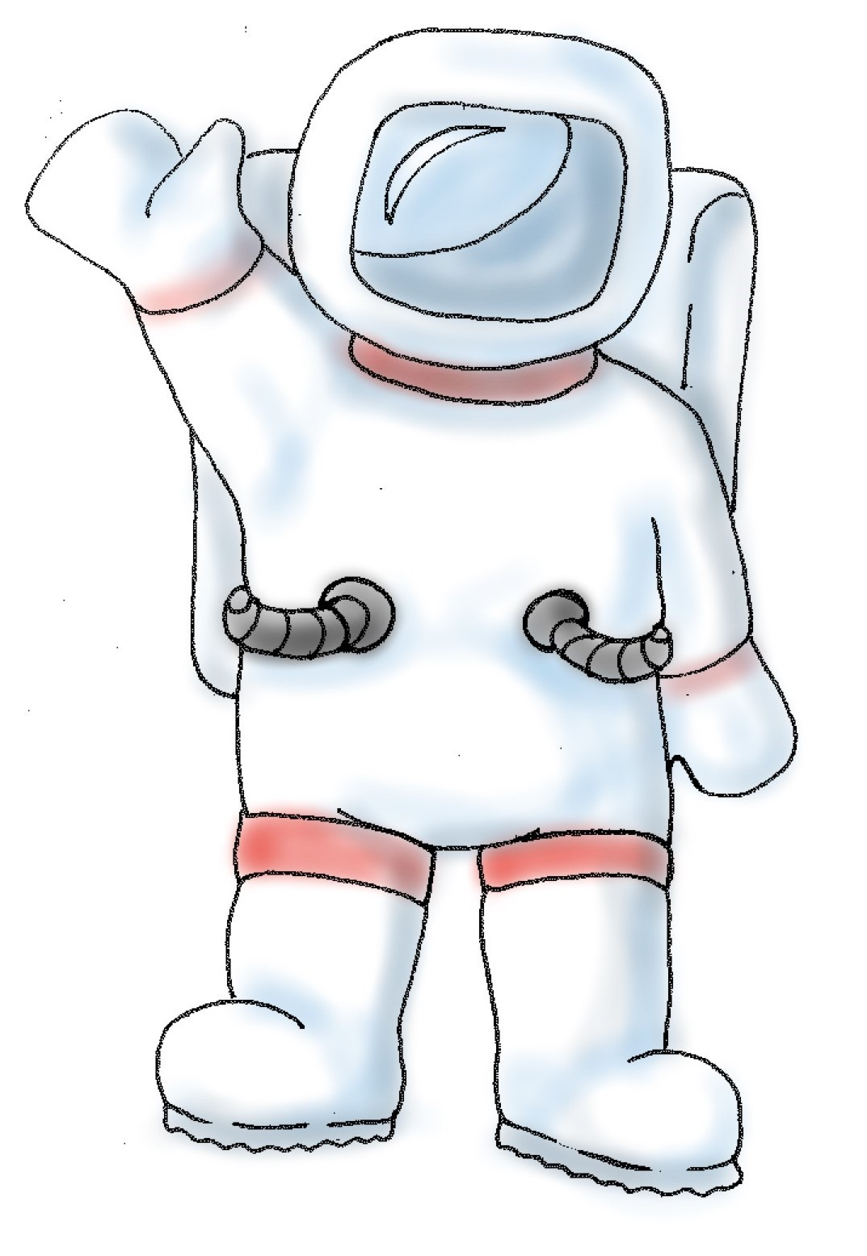
This is Jamie.
S/he is an astronaut.
By Aenne Brielmann, NYU, 2016.

Slide 2
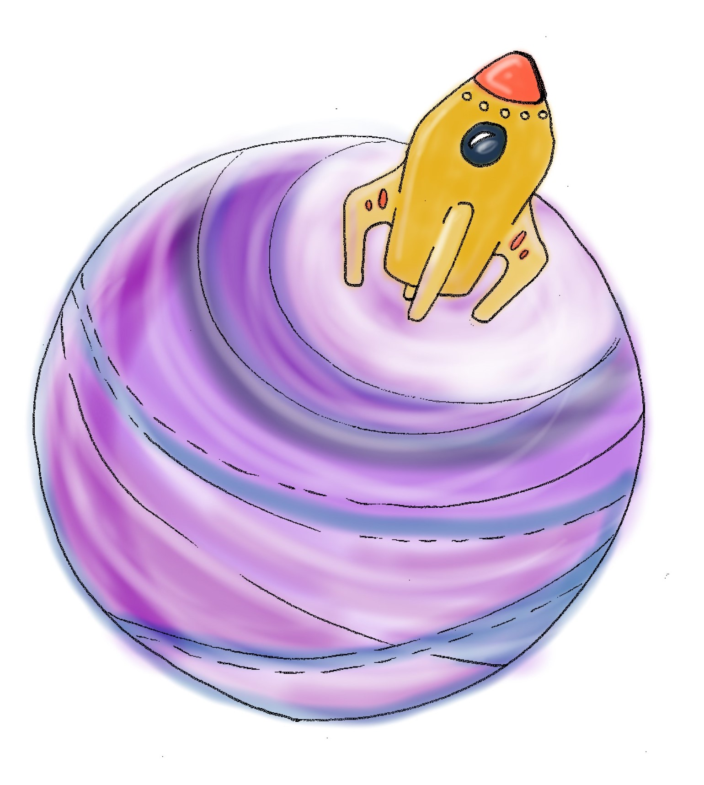
Jamie has landed on a planet far away from his/her home.

Slide 3
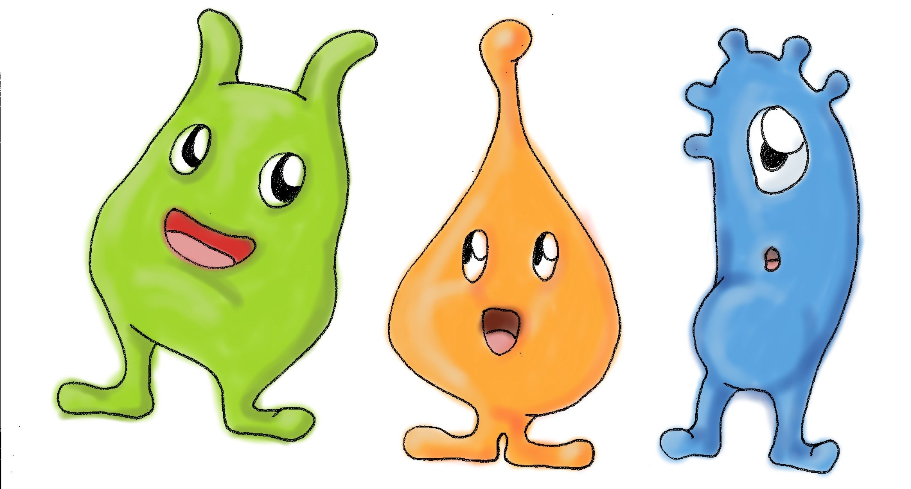
S/he has made some new friends there, alien friends.

Slide 4
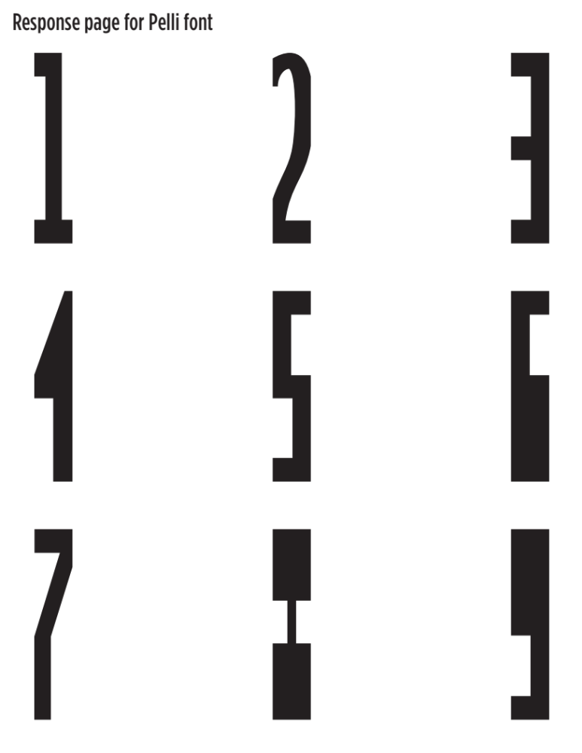
His/her alien friends cannot speak, but they have invented a symbol language to talk to Jamie.
Here are the symbols Jamie and his/her alien friends use.

Slide 5
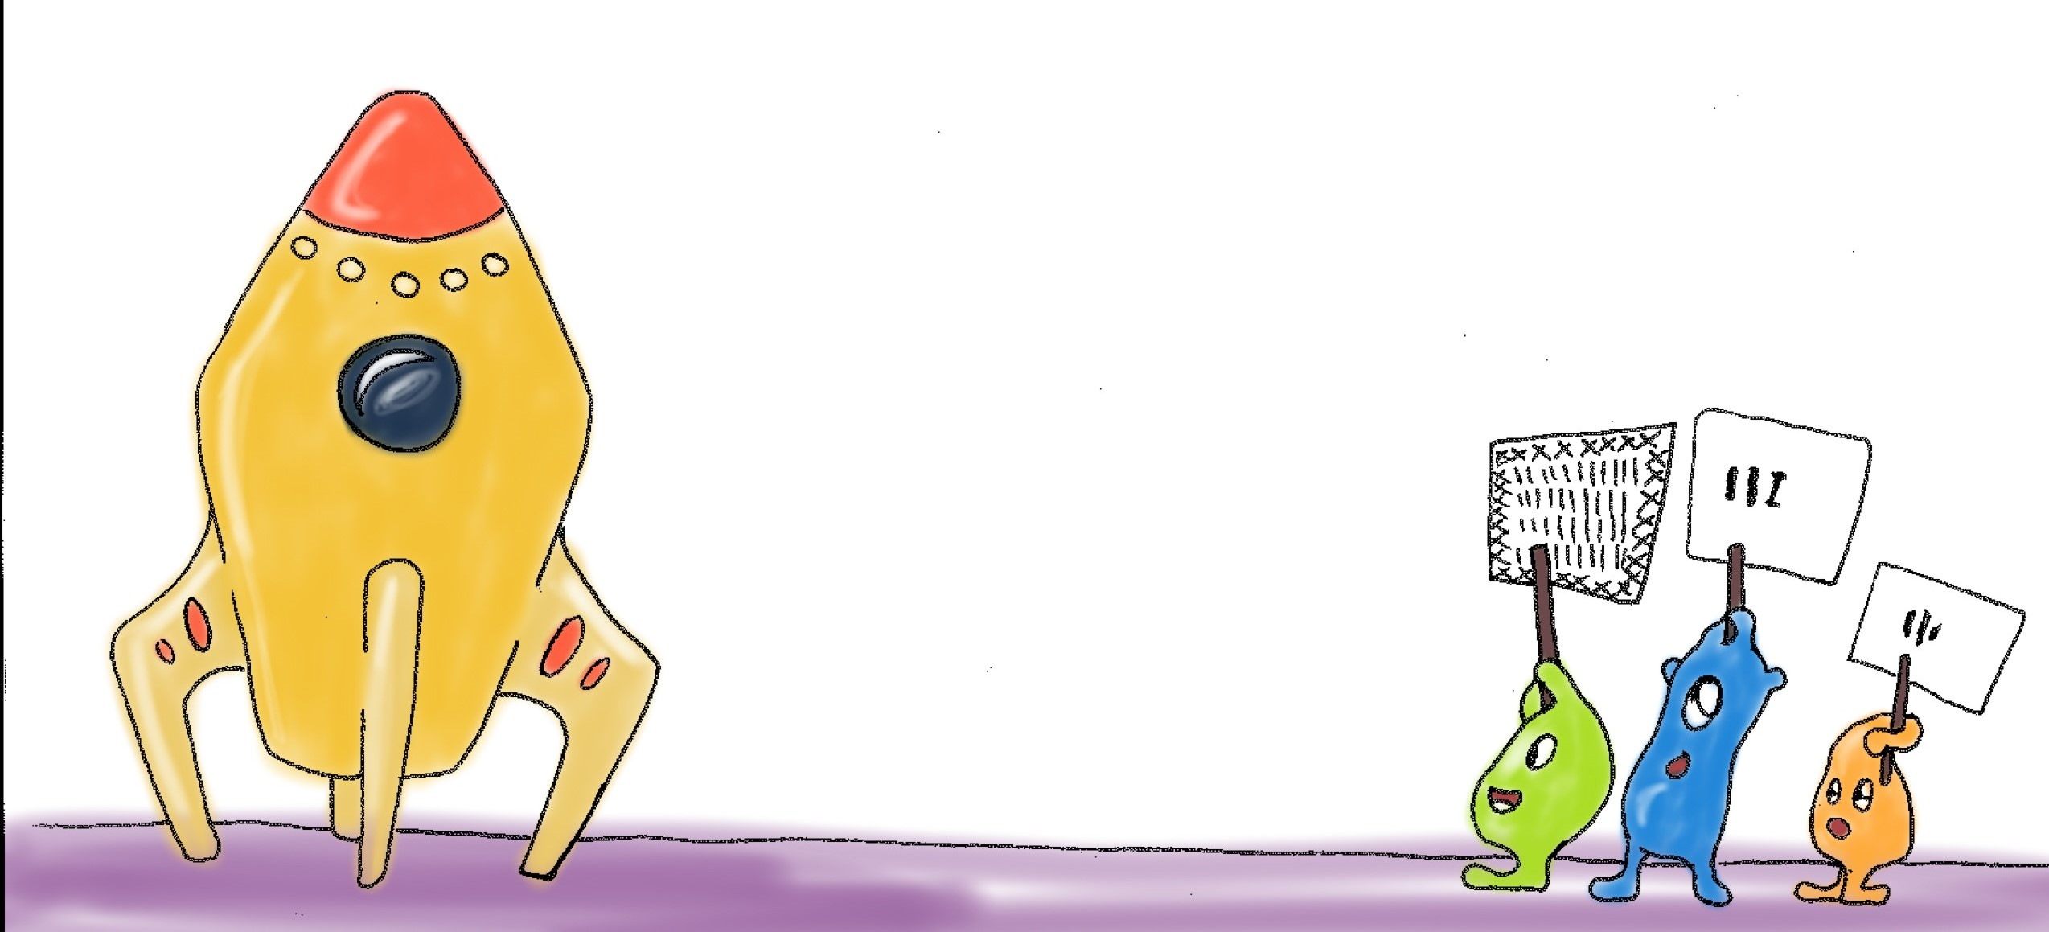
It’s now time for Jamie to fly home. But Jamie’s spacecraft does not have enough fuel to get back home. Uh oh! Jamie is already in his/her spacecraft, and the doors are locked. S/he could fly a few miles to pick up fresh fuel, but s/he does not know where to go. That’s a problem. Luckily s/he has friends. His/her alien friends are trying to tell Jamie where s/he can find more fuel. Yay! But their signs are far away and hard to see. Jamie needs your help.

Slide 6
Can you help Jamie to understand what her friends are trying to tell her?

Slide 7
We will show you the signs that the aliens show to Jamie. You can help Jamie by reading the symbol on the sign and pointing to that symbol on this page. [Give observer the Alphabet Page]. We will tell Jamie your answer.
The signs are very far away and hard to see. So sometimes you’ll just be guessing. That’s ok. Even guesses help Jamie.

Slide 8
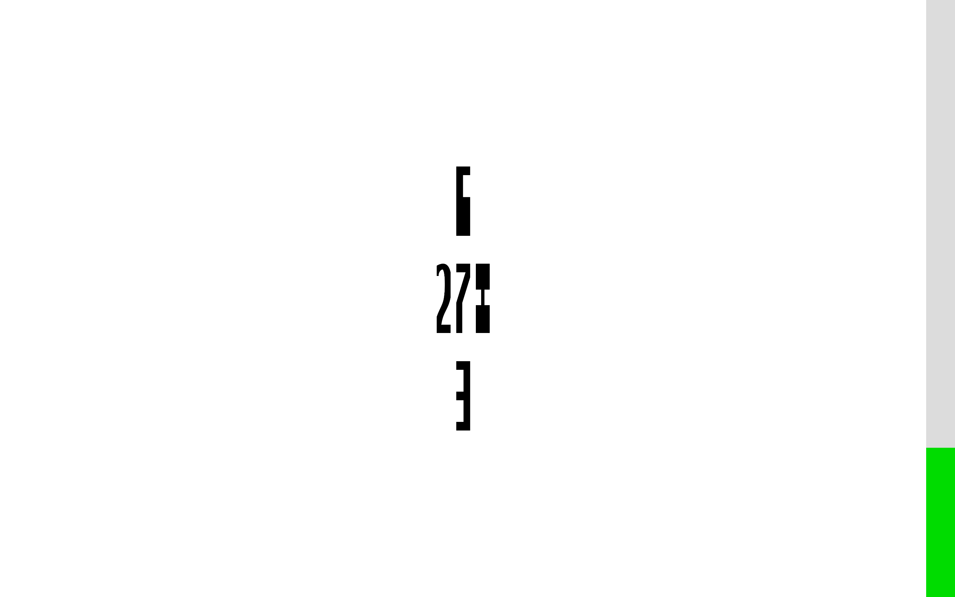
This gray bar is Jamie’s fuel tank. It’s nearly empty. The spaceship fuel is green. When the tank is full of green fuel, Jamie can fly home.

Slide 9
So, are you ready to help Jamie to read his/her alien friends’ signs?

